Slide 1
Formulae Encyclopedia 2.0

Slide 2
Acknowledgement
Our team would like to express a deep sense of thanks and gratitude to our Department of Electronics and Computer Engineering of Thapathali Campus for this great opportunity to present our ideas. We would also like to thank Er. Saroj Shakya Sir for guiding us immensely throughout the project. His constructive advice and constant motivation have been responsible for the successful completion of this project .

Slide 3
Recap of Formula Encyclopedia 1.0
CLI-based app
Formulas stored as .txt files
Use of file handling to add, remove and display formulas
Hard to use, non-aesthetic

Slide 4
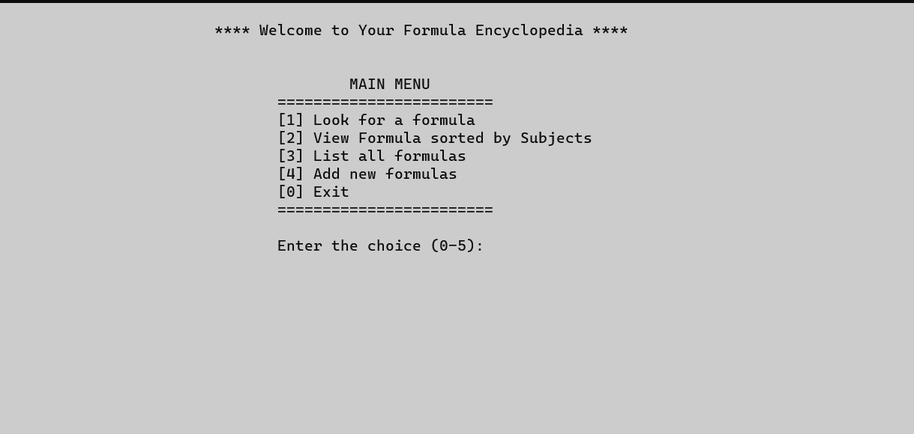
Recap of Formula Encyclopedia 1.0
Home Screen

Slide 5
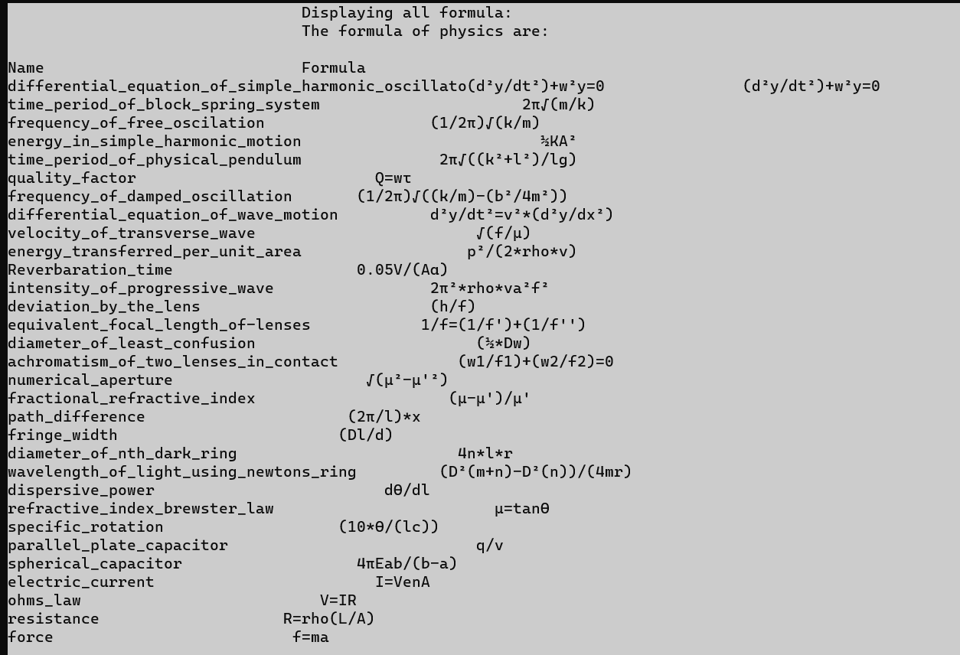
Recap of Formula Encyclopedia 1.0
Displaying Formulas :

Slide 6
Introduction To Formulae Encyclopedia 2.0
Improved version of CLI-based Formula Encyclopedia
Use of MySQL and QT libraries for development.
Compiles formulae used in our engineering journey
Helps student focus on actual problem rather than wasting time to lookup formulas

Slide 7
Why Formulae Encyclopedia 2.0?
Easy to eye, user friendly UI
Straight forward navigation
Subject-wise categorization
Fast, memory efficient, requires very less resource

Slide 8
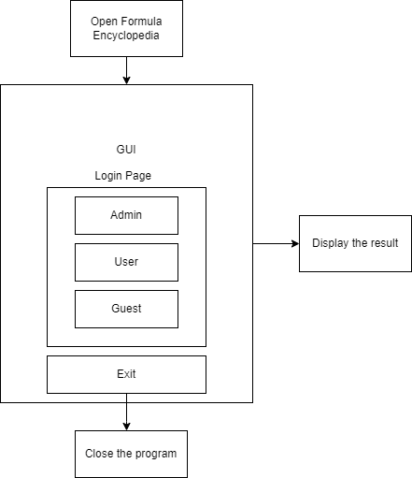
Methodology
GUI based Application
Has 3 different modes to log in
Admin
To register, delete, view users
User
Look for a formula
View formula sorted by subjects
Guest
View limited formulas

Slide 9
Methodology
The core programming of this project has been done using Qt 6.4.0 libraries and C++ .
Use of Database management system(MySQL) to organize the formulae and login credentials.
Formulas are stored as image (.png) as resource files in Qt
The title and paths of formulas are stored in the database.

Slide 10
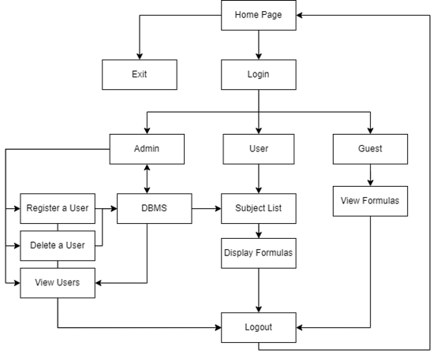
Methodology

Slide 11
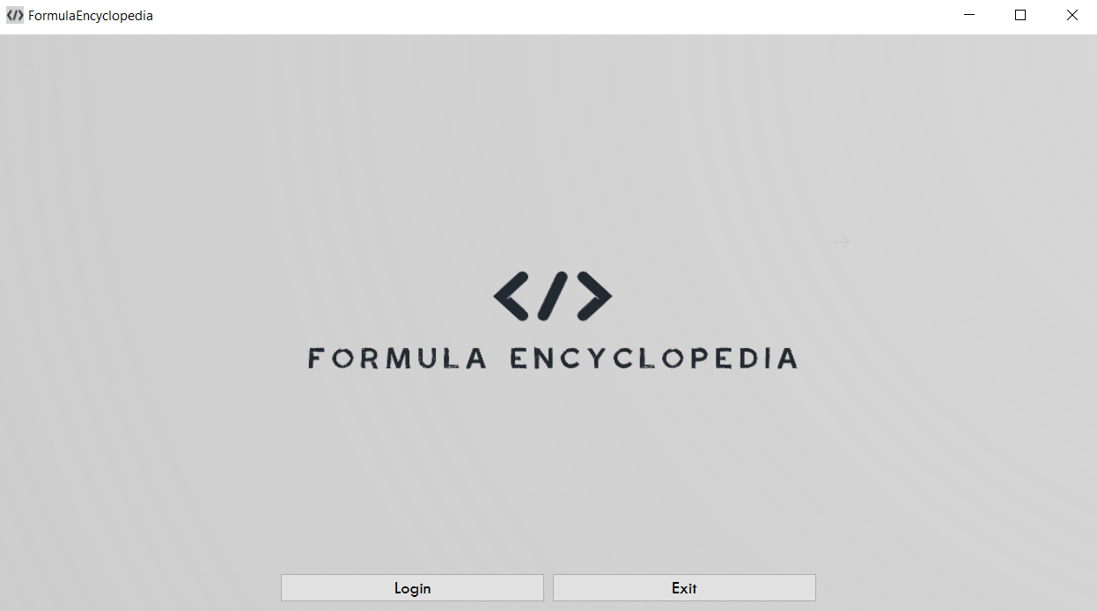
Home Screen

Slide 12
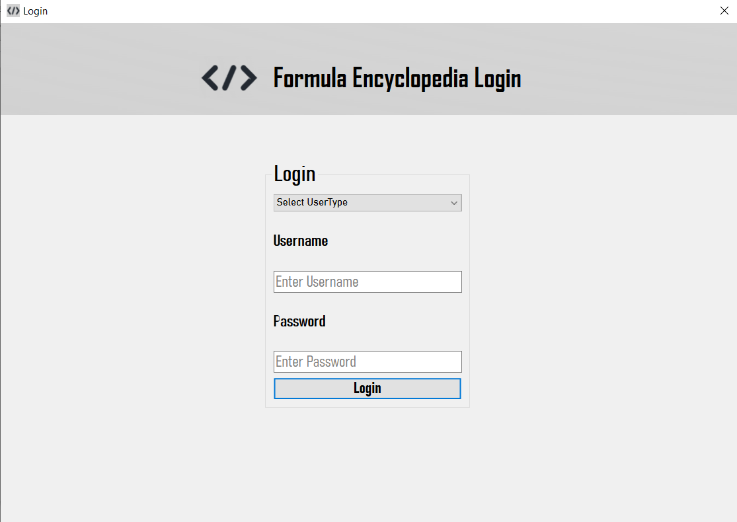
Login Page

Slide 13
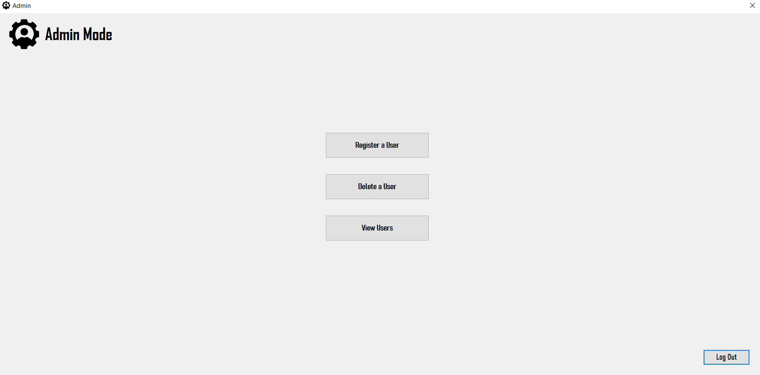
Mode1 : Admin Mode

Slide 14
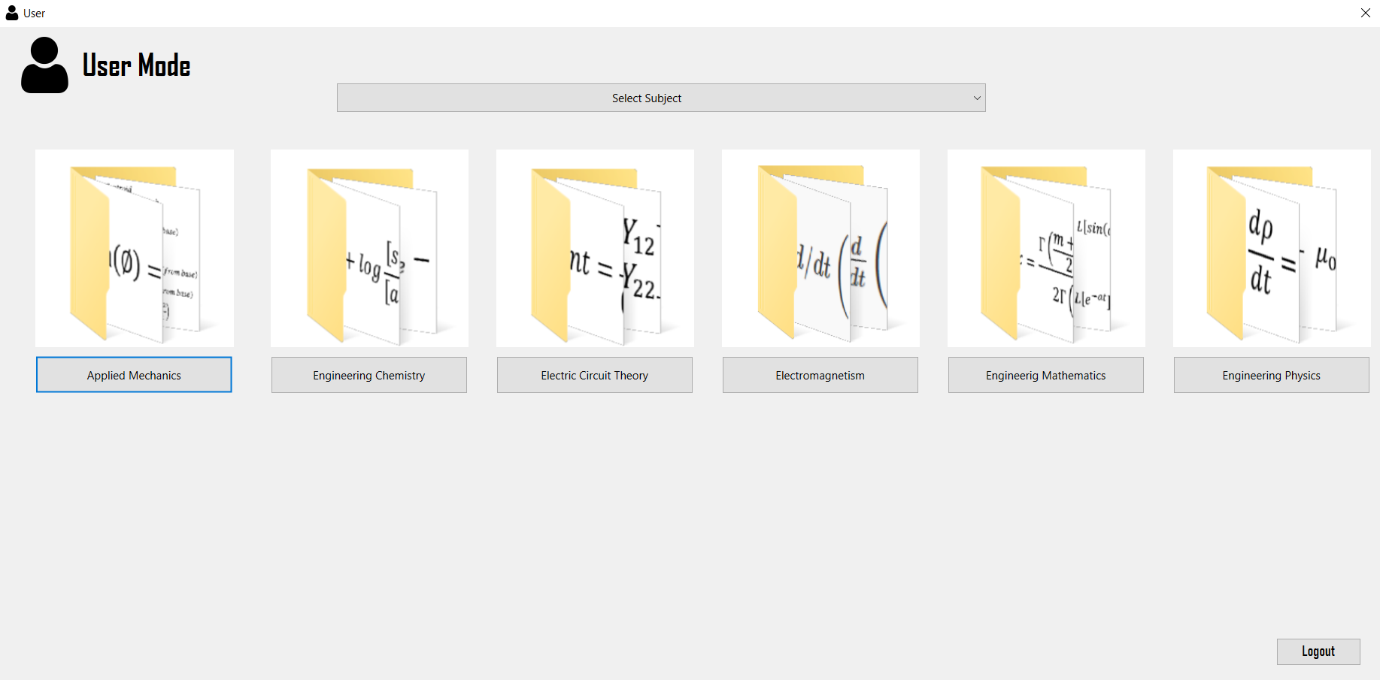
Mode 2: User Mode

Slide 15
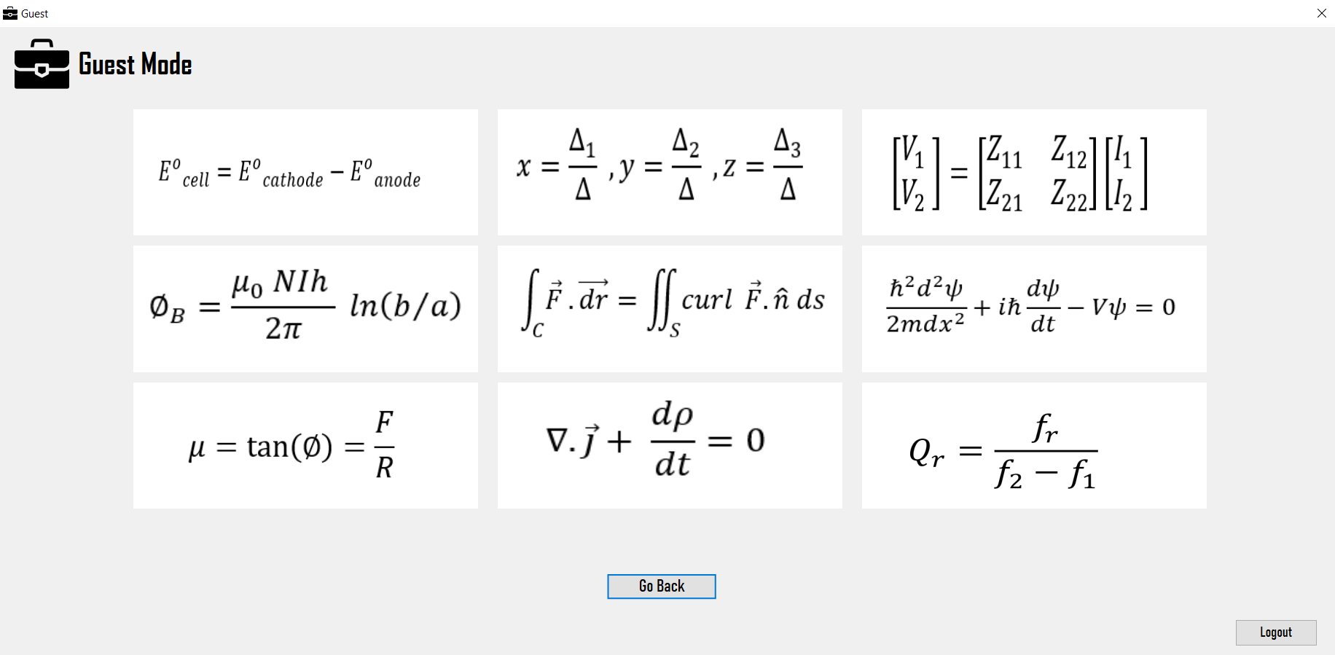
Mode 3 : Guest mode

Slide 16
Limitations
The application window is not resolution adaptive.
Searching by keyword is not possible
Formulas and subjects cannot be dynamically managed.
Databases are not hosted online.

Slide 17
Future Enhancements
Application can be made auto adaptive as per the resolution of the device.
Search functionality can be added for easier navigation.
Formulas and subjects can be made dynamically managed.
Databases could be hosted online.

Slide 18
Conclusion
An easy to use GUI application was developed using C++.
Makes it easier for students to lookup formulas
As a Developer we got a chance to learn about the basics of Qt Libraries, DBMS and to collaborate with other team members.
We also learned about version control system using Git and GitHub for easy collaboration and tracking of project progress.

Slide 19
THANK YOU !!
Team
Atul Shreewastav
Bidhan Acharya
Nischal Paudel
Yugratna Humagain

